Slide 1
Thoughts on reproducibility
Lex Nederbragt
With input from Geir Kjetil Sandve
Dept. of Informatics, UiO

Slide 2
Outline
A bit about me
Reproducibility
Tools for ‘doing’ bioinformatics

Slide 3




whoami
@lexnederbragt
flxlexblog.wordpress.com

Slide 4
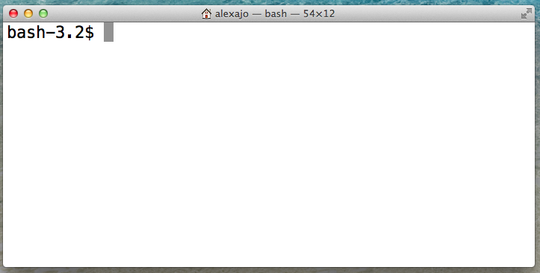
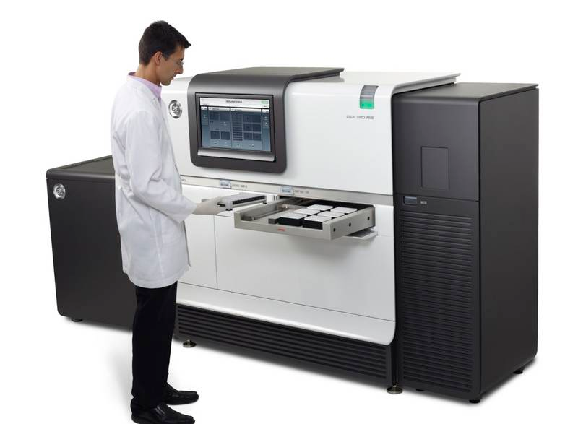
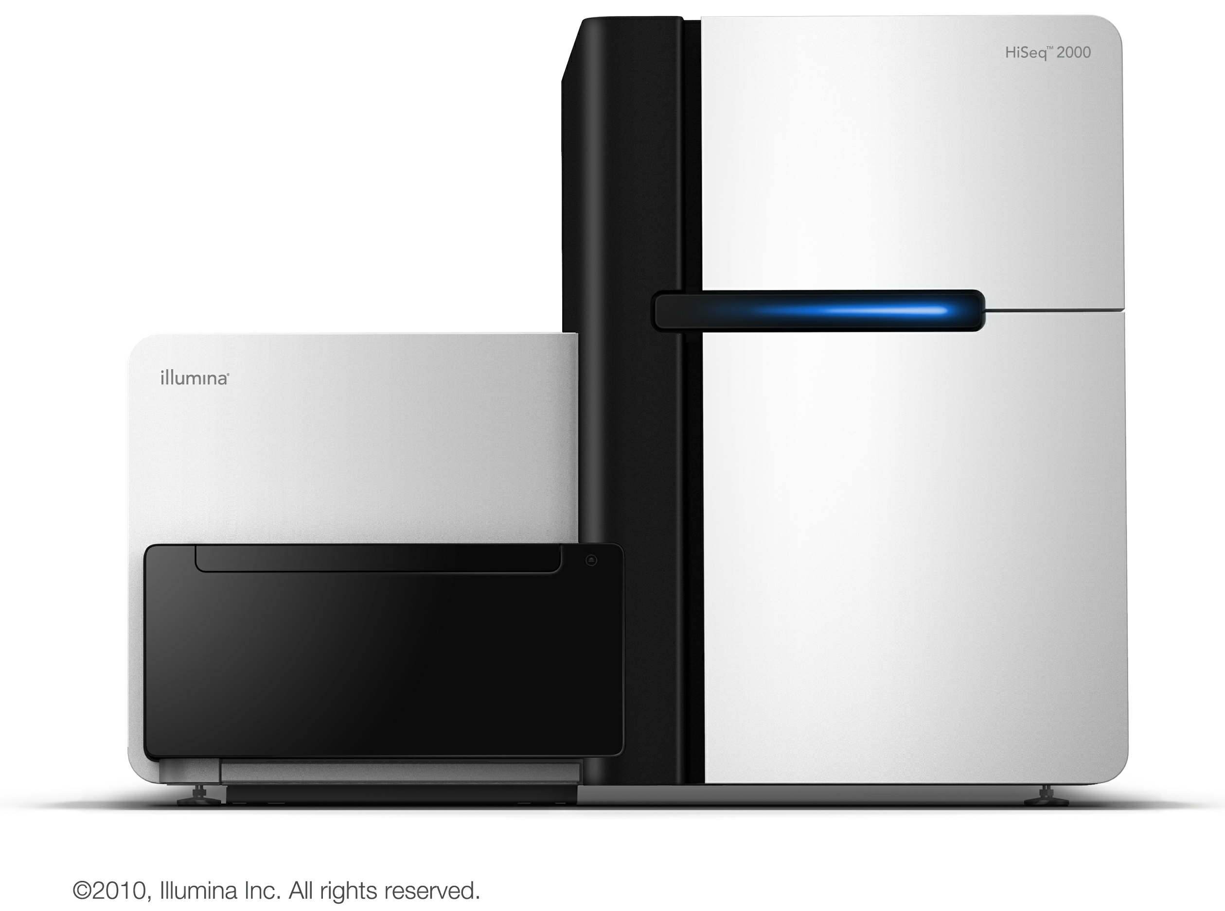
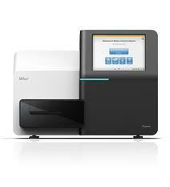
whatdoido

Slide 5
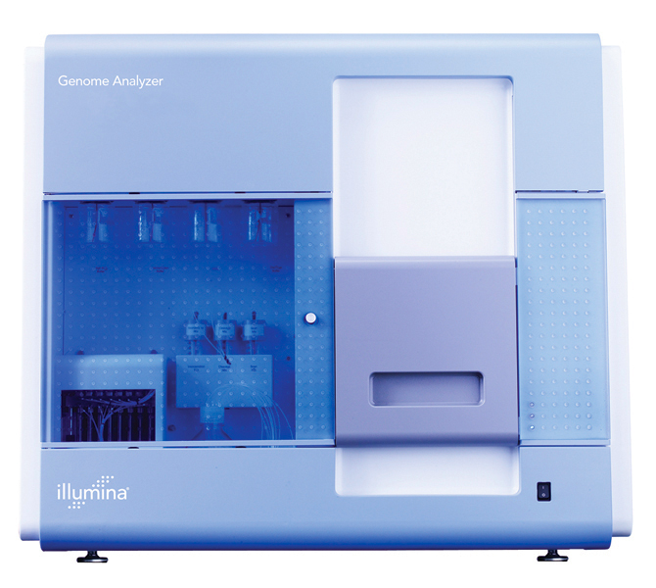
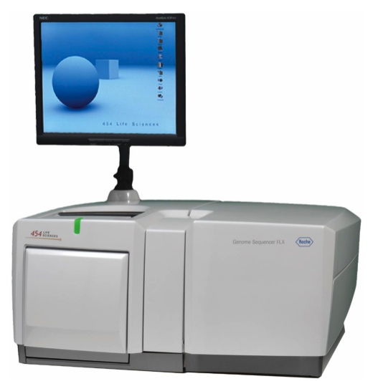
howdidistart
2007: a grant
?
GS FLX from Roche/454
Genome Analyzer from Solexa/Illumina
Let’s try them out!

Slide 6
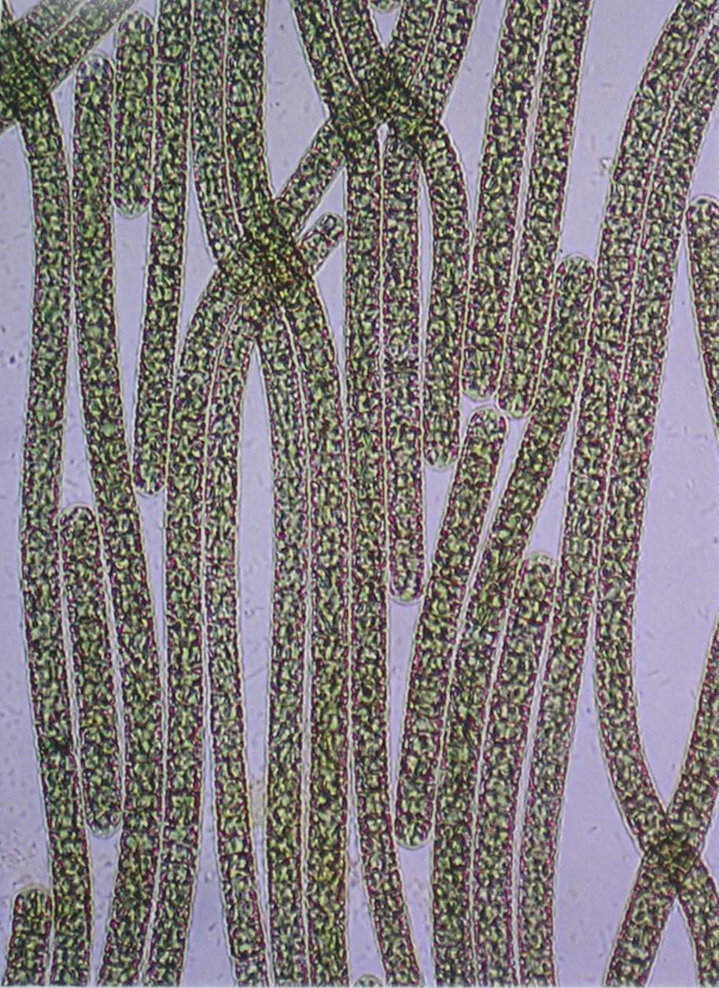
howdidistart
Specimen
Planktothrix rubescens NIVA CYA 98
Cyanobacteria
(blue-green algae)

Slide 7
howdidistart
Half a million reads
Average length 250 nt
10 million reads
33 nucleotides each
Assembly?
Assembly?

Slide 8

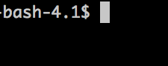

howdidistart
Half a million reads
Average length 260 nt
10 million reads
33 nucleotides each
Perl

Slide 9

In summary
From flickr, user lesterpubliclibrary

Slide 10

What is ‘Reproducible research’?
“Reproducibility is the ability of an entire experiment or study to be reproduced
either by the researcher or by someone else working independently.
It is one of the main principles of the scientific method.”
Wikipedia

Slide 11
Reproducibility

Slide 12
Reproducibility: why?
TRUST

Slide 13
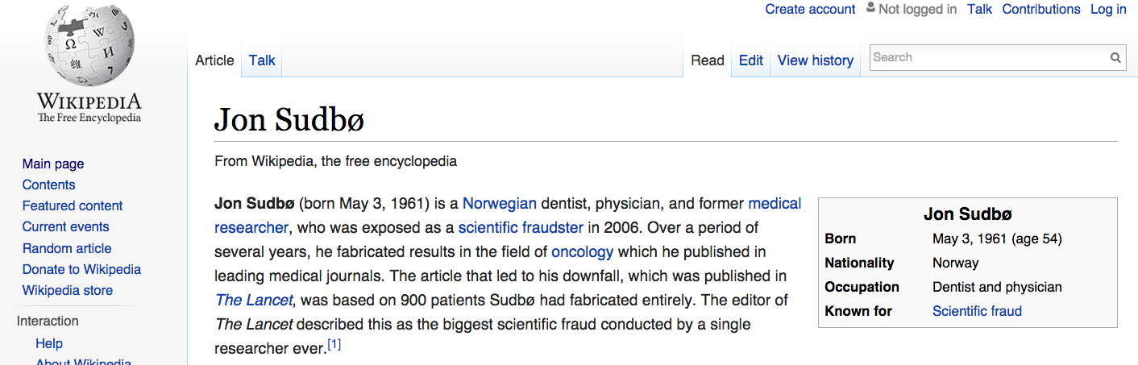
The worst case

Slide 14

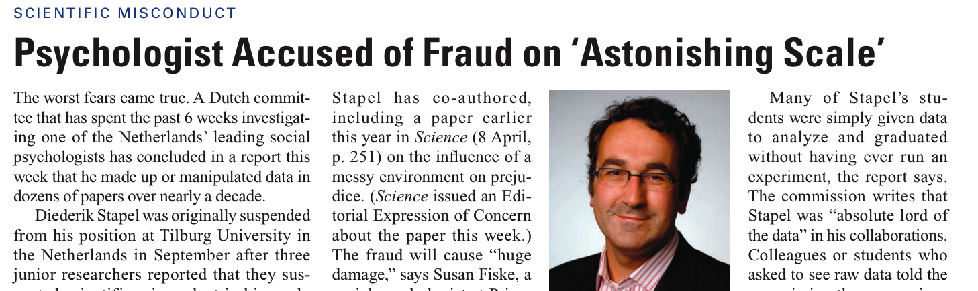
The worst case
https://www.sciencemag.org/content/334/6056/579.full.pdf

Slide 15
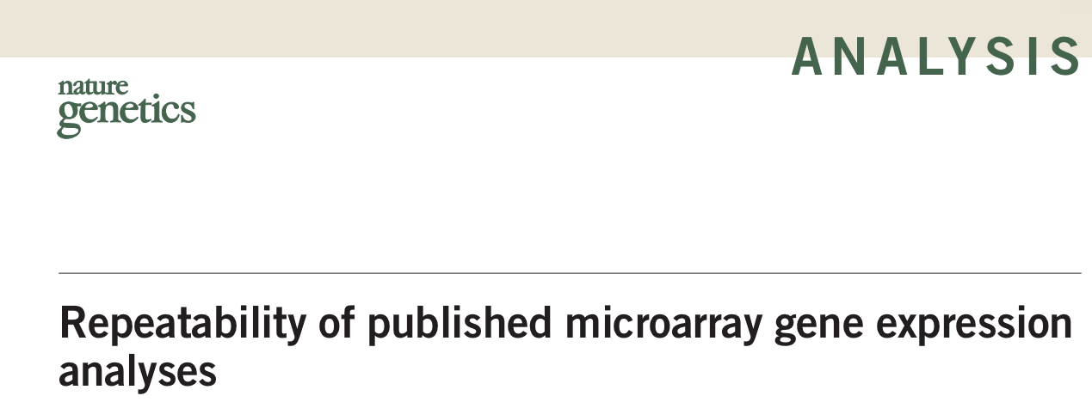
How bad is it?
Nat Genet 41(2):149-55
Less than half of selected microarray experiments published in Nature Genetics could be reproduced

Slide 16
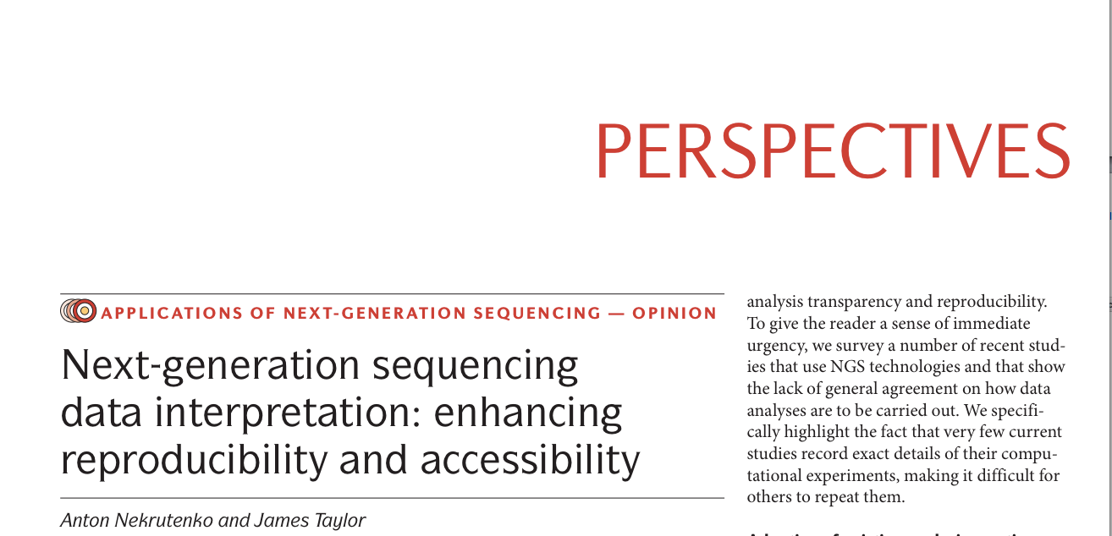
How bad is it?
Nat Rev Genet 13(9):667-72
Nat Rev Genet 13(9):667-72
“More than half [of surveyed papers] do not provide primary data and list neither the version nor the parameters used [for read mapping]”

Slide 17
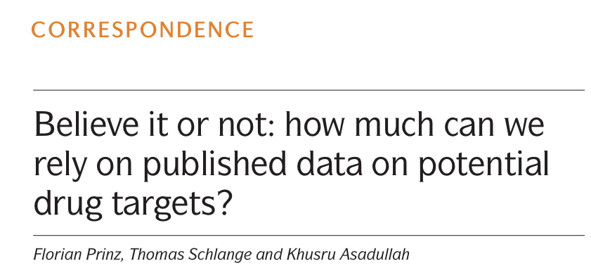
A reproducibility crisis?
Nat Rev Drug Discov. 10(9):712)
Lack of reproducibility related to a sharply increasing rate and failed clinical trials?

Slide 18
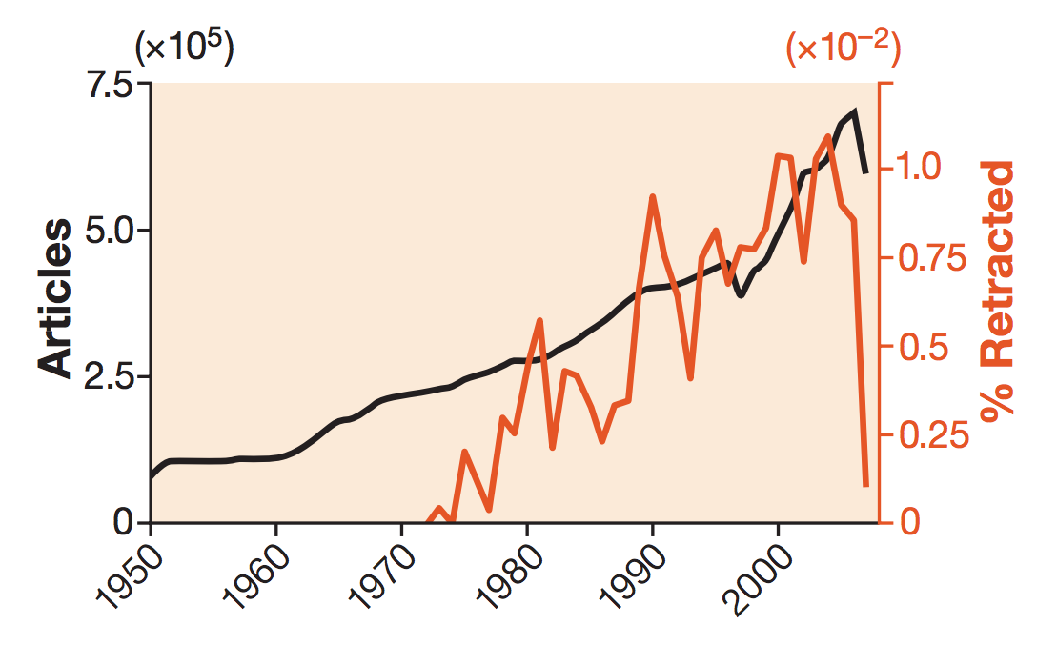
A reproducibility crisis?
Retraction rates are on the rise Murat Cokol, Fatih Ozbay & Raul Rodriguez-Esteban
EMBO reports (2008) 9, 2 doi:10.1038/sj.embor.7401143

Slide 19
An example from our own work
2011

Slide 20
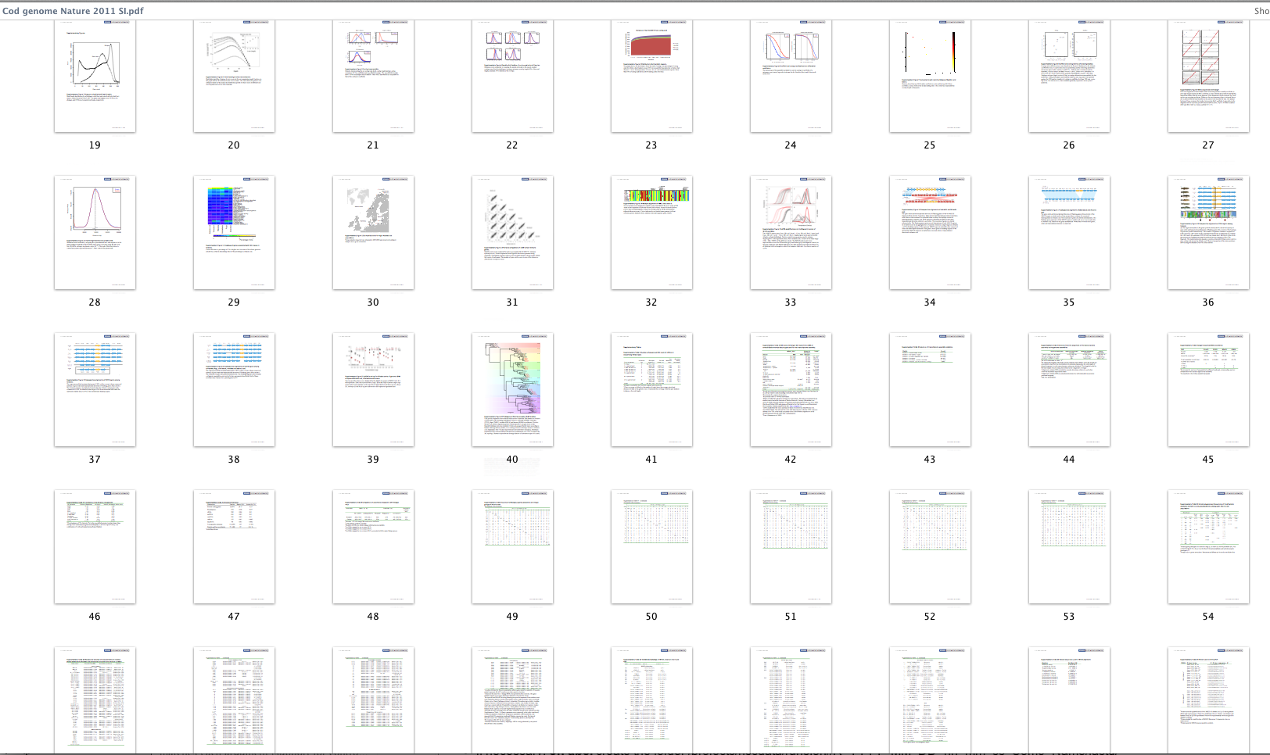
An example from our own work
Are all these figures/tables reproducible?
Supplementary information, page 19-63 of 72

Slide 21
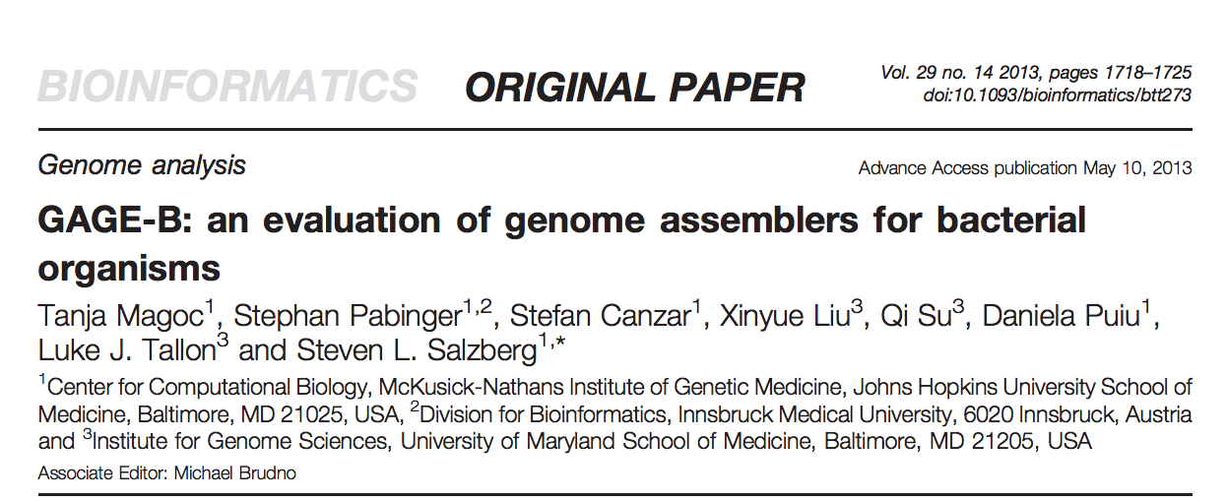
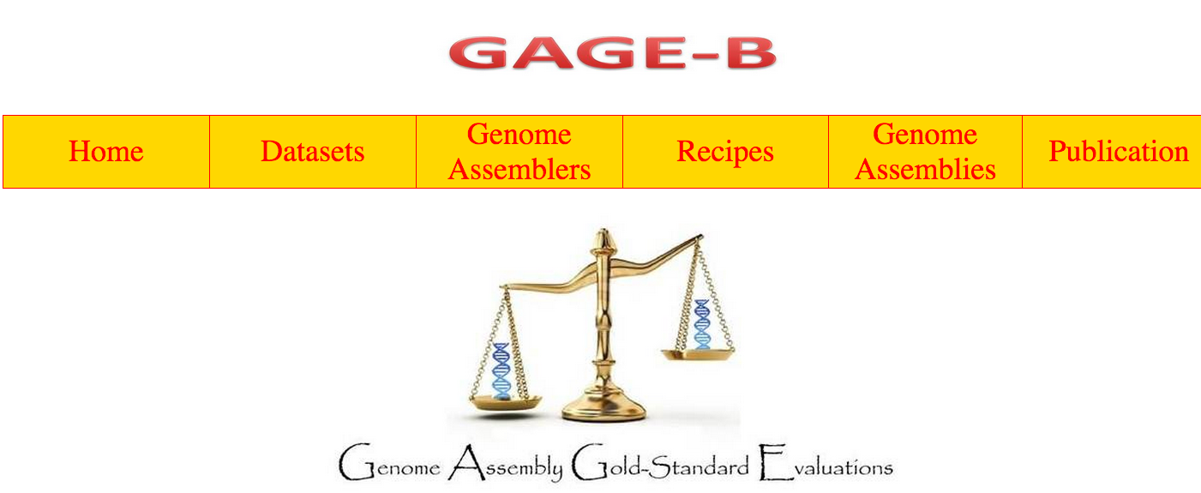
An exercise in reproducibility
Master student project at informatics Sabba Ifzal

Slide 22
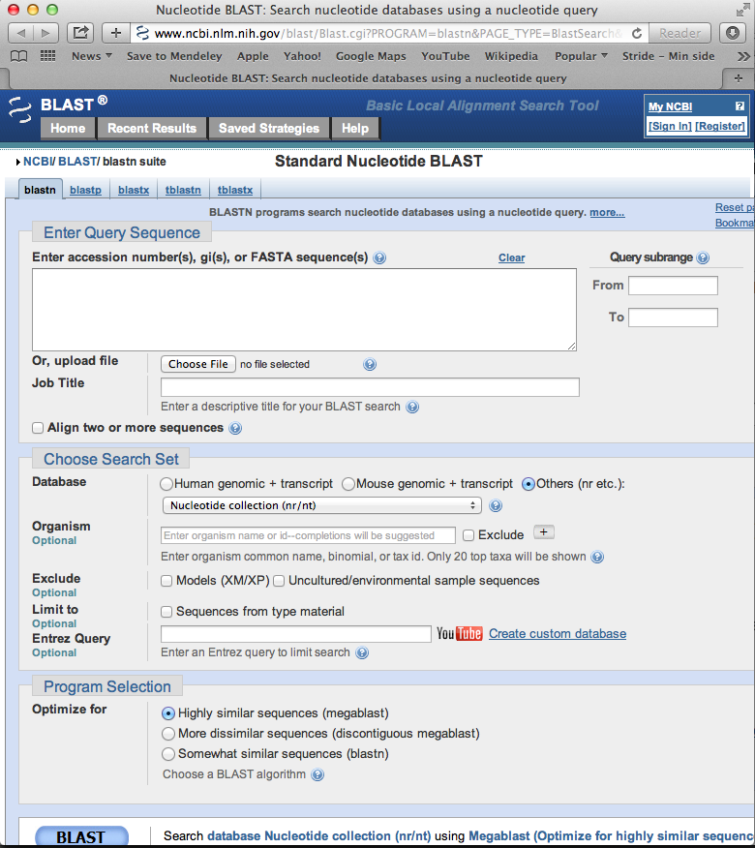
Blast

Slide 23
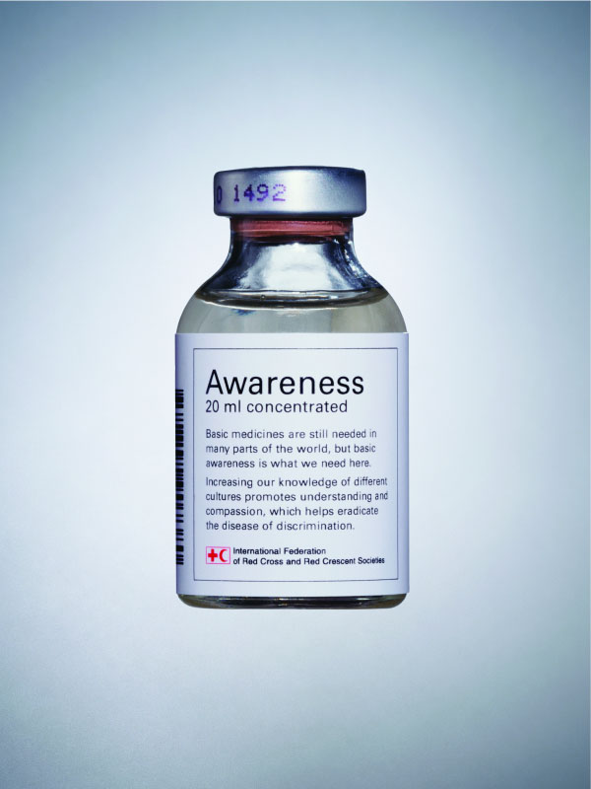
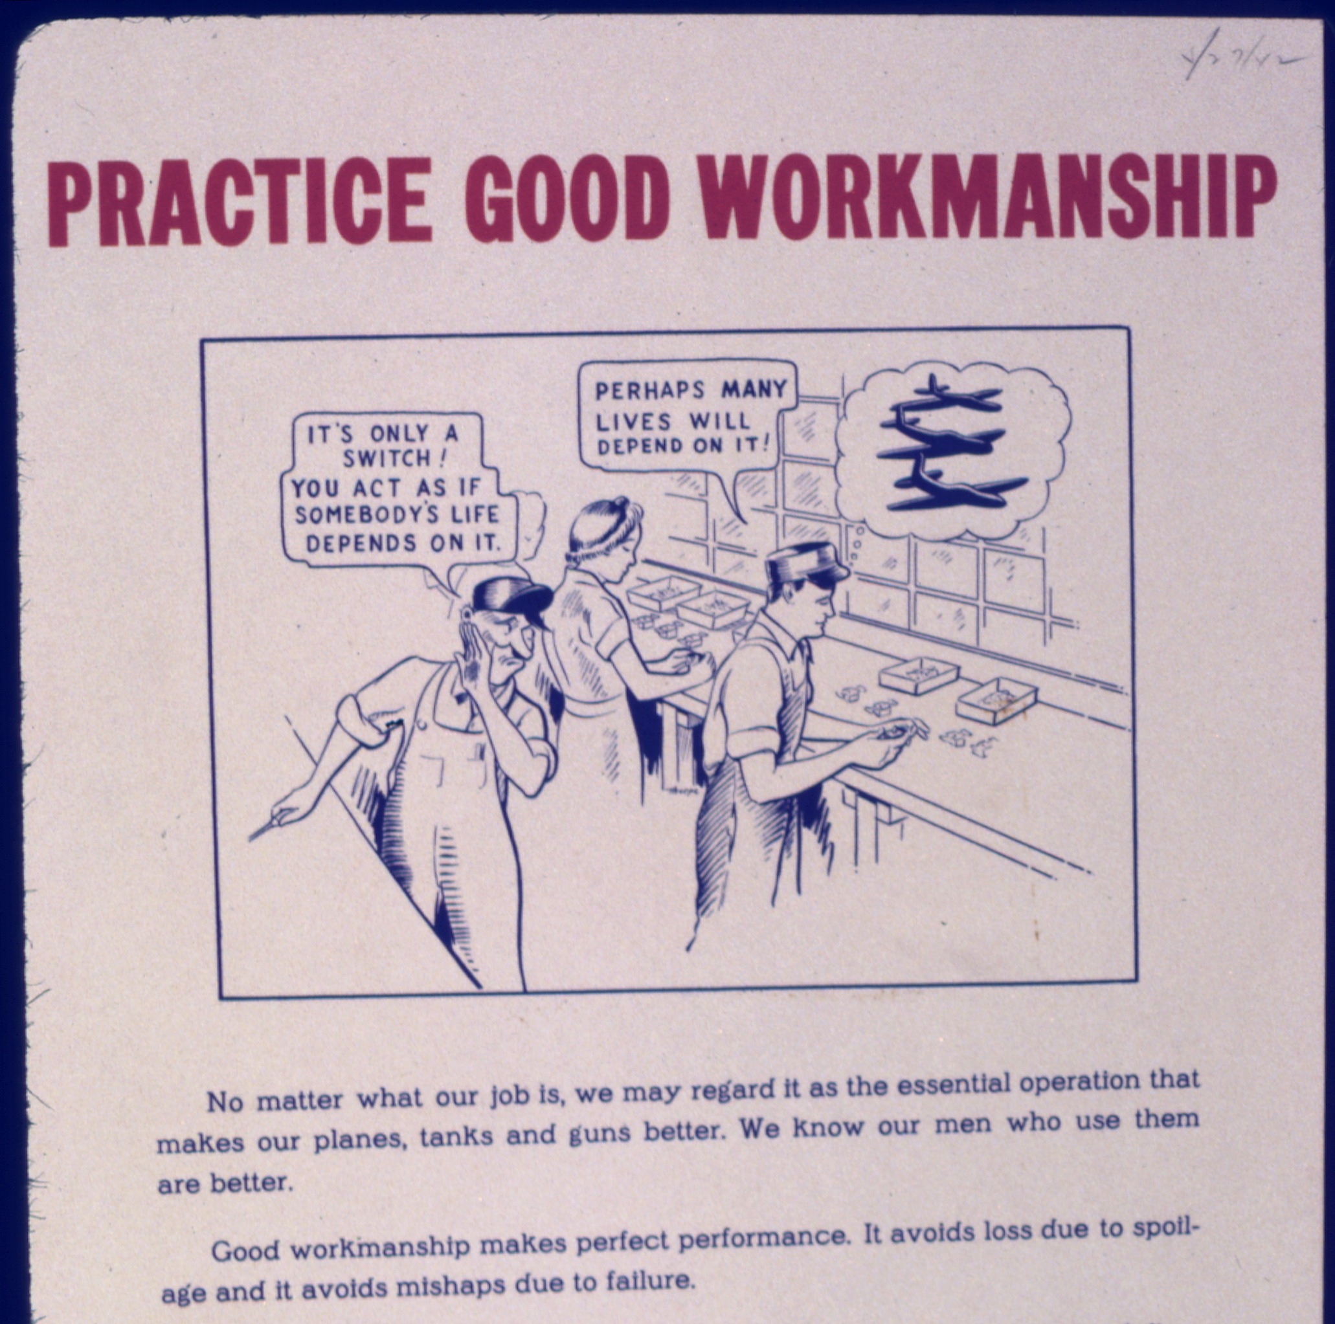
Solutions
Flick: http://farm4.staticflickr.com/3319/3265787219_bfbc654b5e_o.jpg
Wikimedia commons

Slide 24
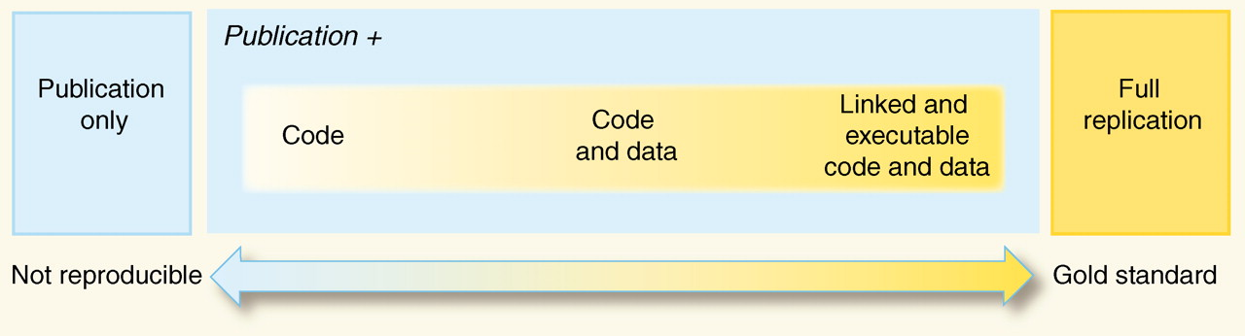
Reproducibility spectrum
Peng (2011) doi: 10.1126/science.1213847

Slide 25

Reproducibility and reusability
http://upload.wikimedia.org/wikipedia/commons/4/48/Recycle.jpg

Slide 26
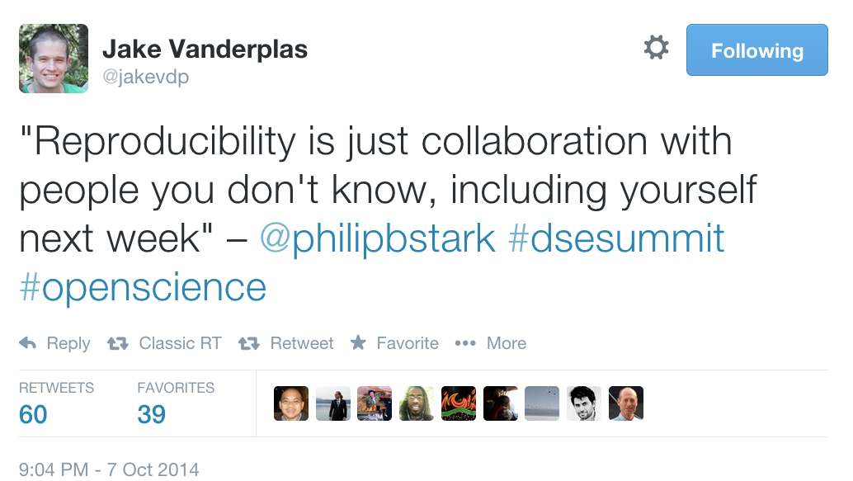
Reproducibility: why?

Slide 27

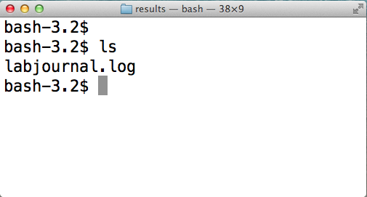
How to make your research reproducible
Document your work

Slide 28
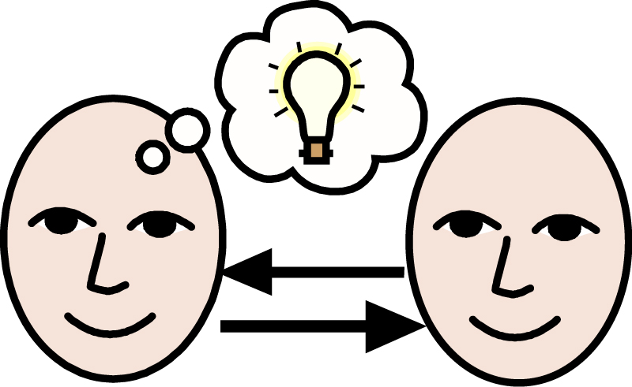
How to make your research reproducible
SHARE
http://howdoitradestocks.com/wp-content/uploads/2011/12/share-ideas1.jpg

Slide 29
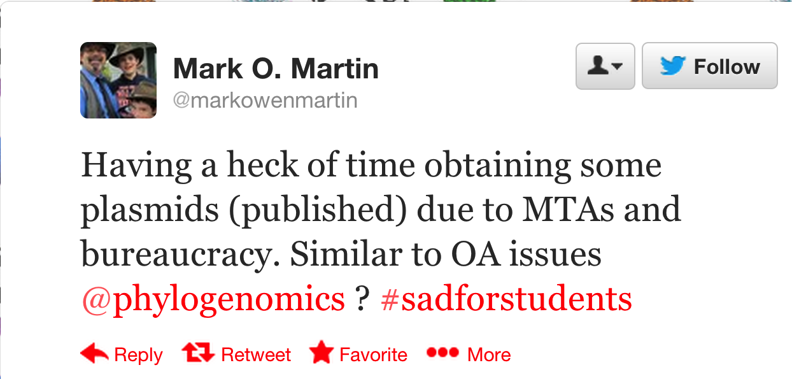
How to make your research reproducible
SHARE
https://twitter.com/vsbuffalo/statuses/377651287133003776

Slide 30
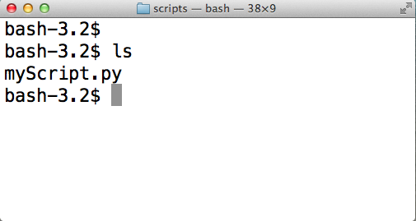
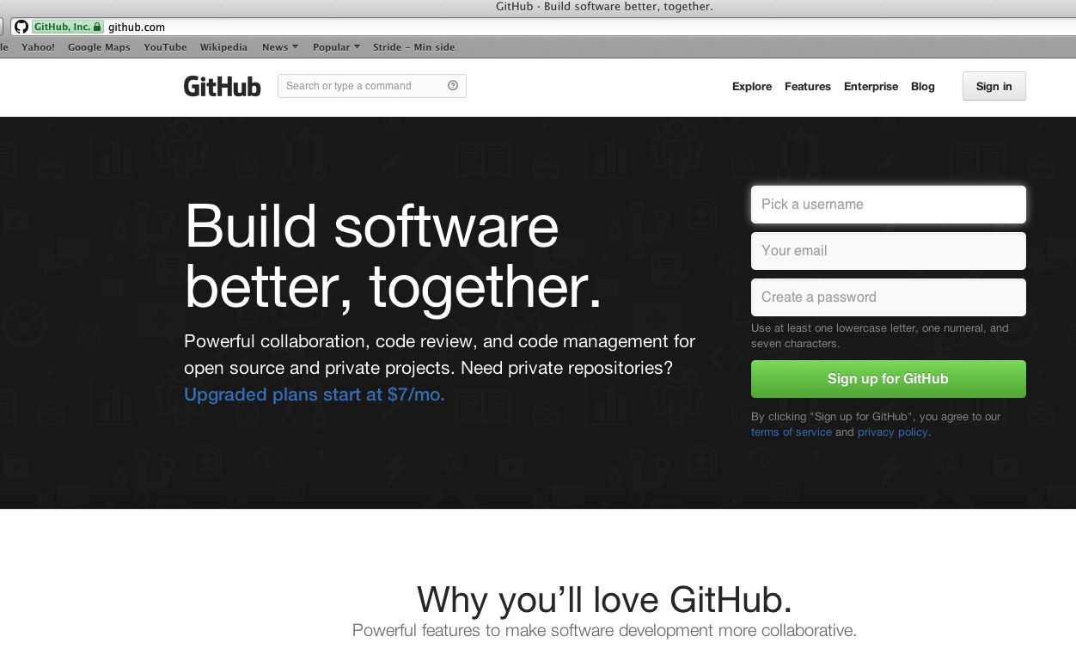
How to make your research reproducible
https://github.com/lexnederbragt
SHARE

Slide 31
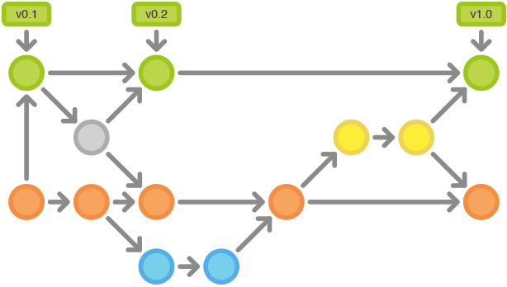
How to make your research reproducible
Version control
https://www.atlassian.com/git/workflows

Slide 32

How to make your research reproducible

Slide 33


How to make your research reproducible
http://software-carpentry.org
http://www.datacarpentry.org

Slide 34
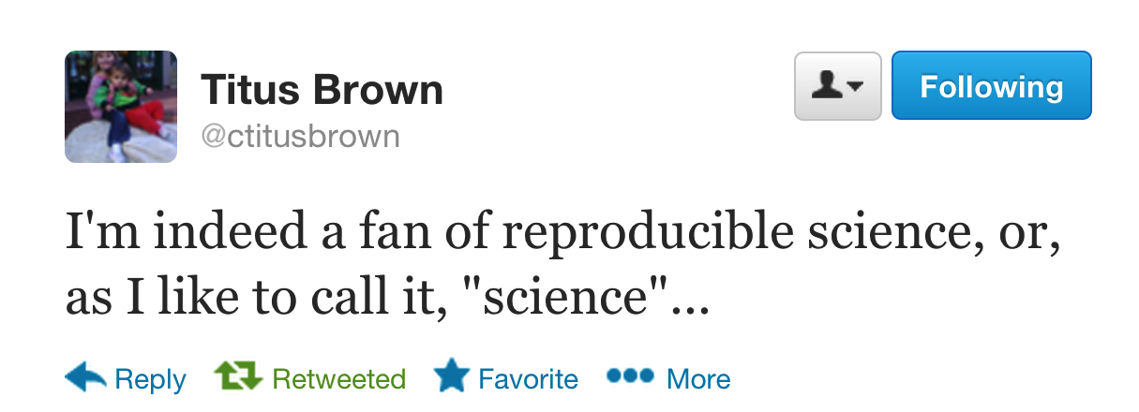
https://twitter.com/ctitusbrown/status/383730337811296256

Slide 35
Tools for ‘doing’ bioinformatics
Modified from Geir Kjetil Sandve, institute of informatics, UiO

Slide 36
What tools do you use?

Slide 37
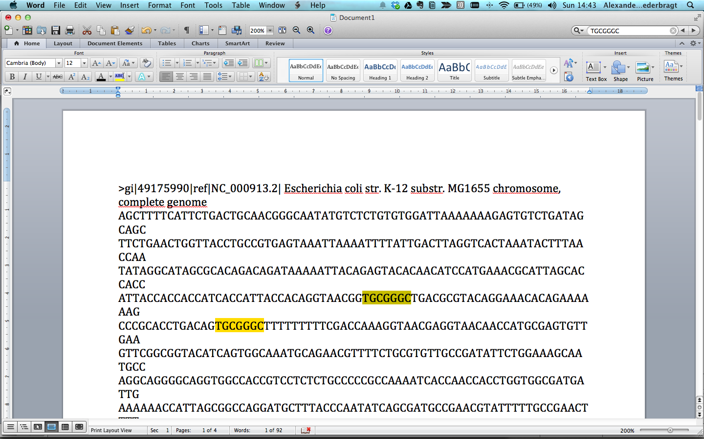
Microsoft Word
✔Possible, familiar environment
✖ impractical, limited, not very reproducible

Slide 38
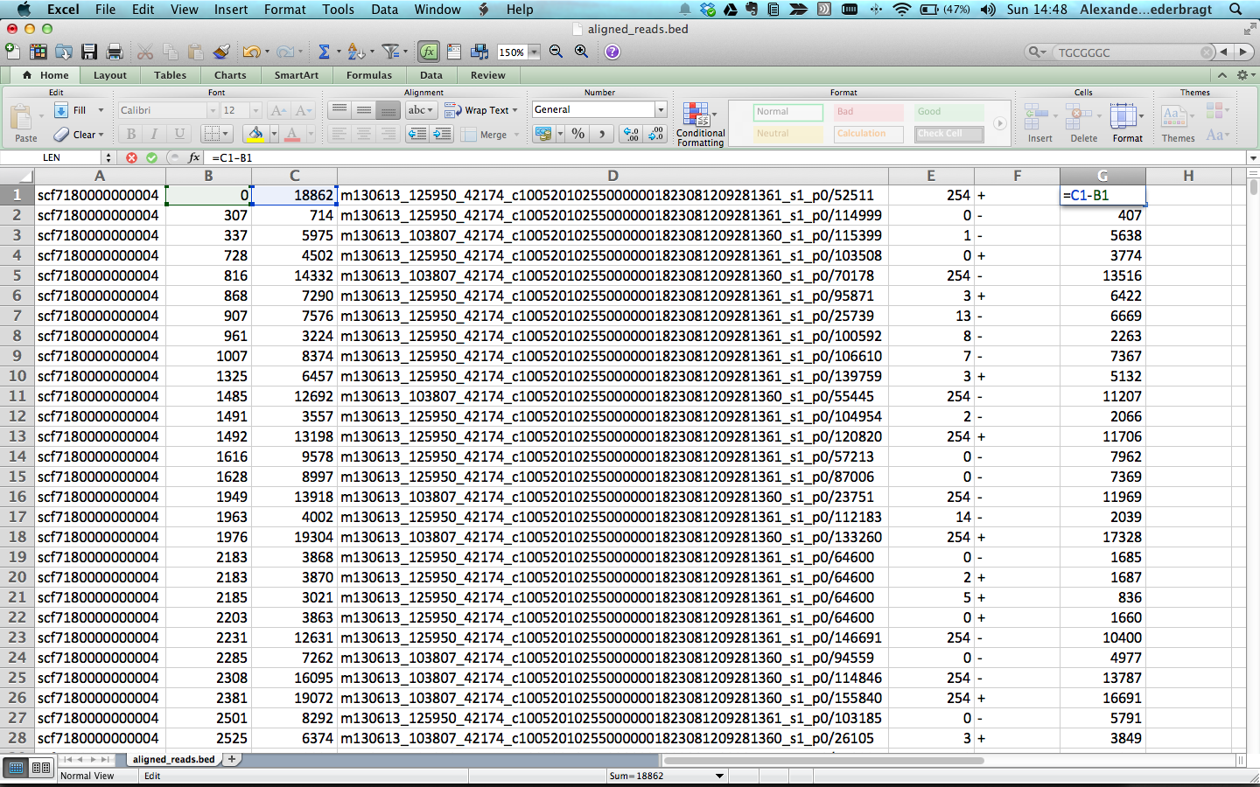
Microsoft Excel
✔Possible, somewhat powerful
✖ limited, not very reproducible

Slide 39
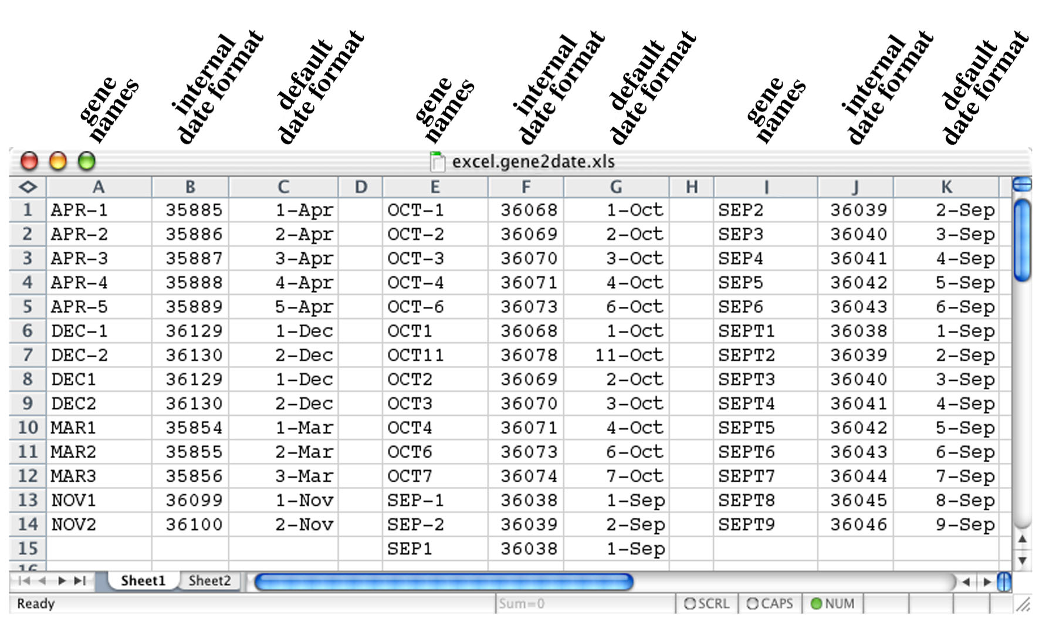
Microsoft Excel
Gene names – oh oh…
BMC Bioinformatics 2004, 5:80 doi:10.1186/1471-2105-5-80

Slide 40
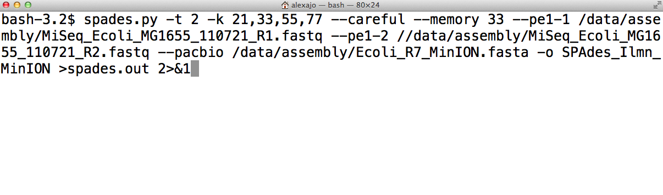
Unix shell
✔Powerful, close to operating system, many tools
✖ Steep learning curve, dependency hell

Slide 41
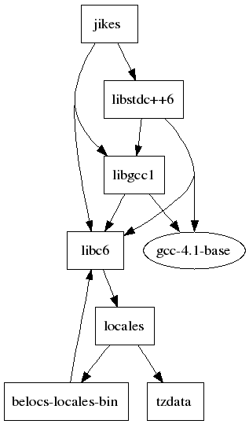
Unix shell
Constant stream of new software
hard to judge if programs are
any good
sometimes a challenge to
install a program and
get it working
http://neidetcher.com/ubuntu_package_dependency.html

Slide 42
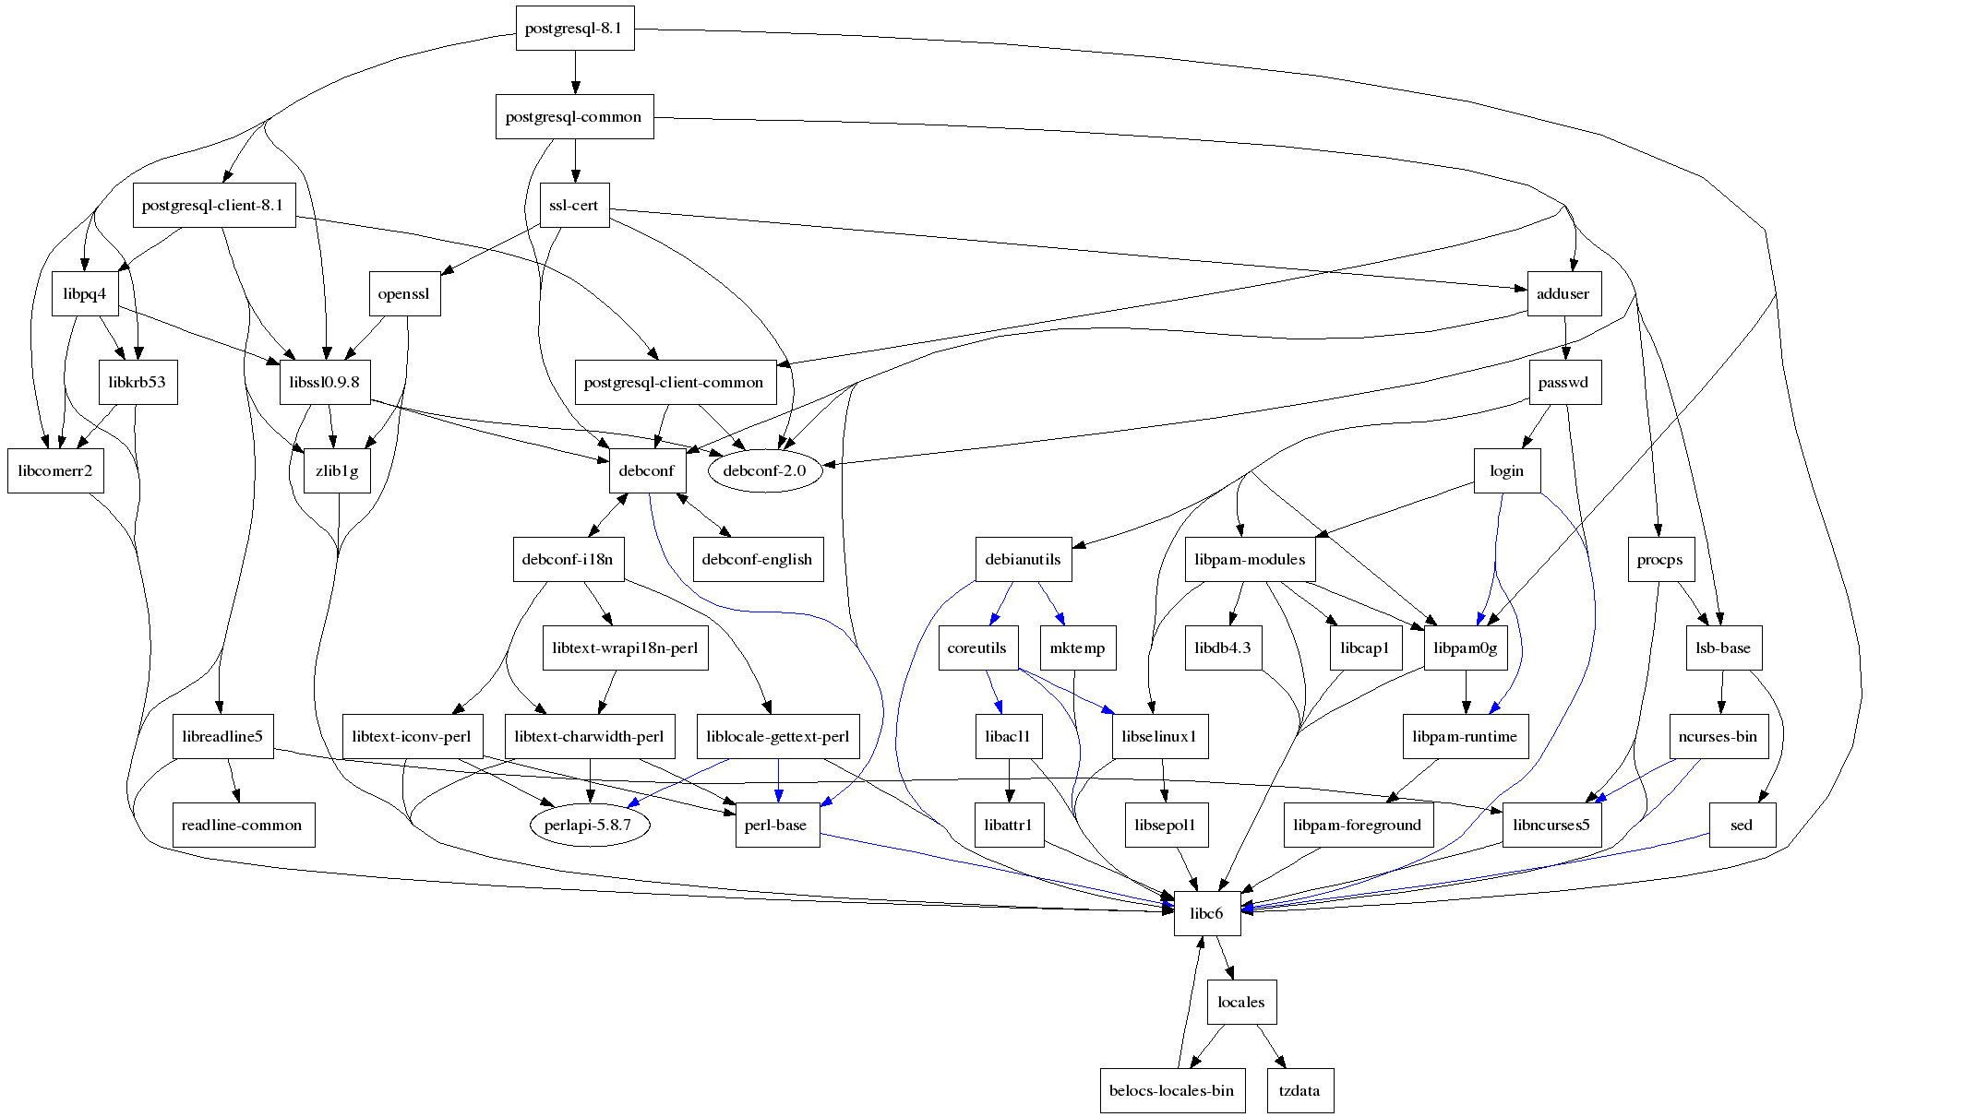
Dependency hell
http://neidetcher.com/ubuntu_package_dependency.html

Slide 43
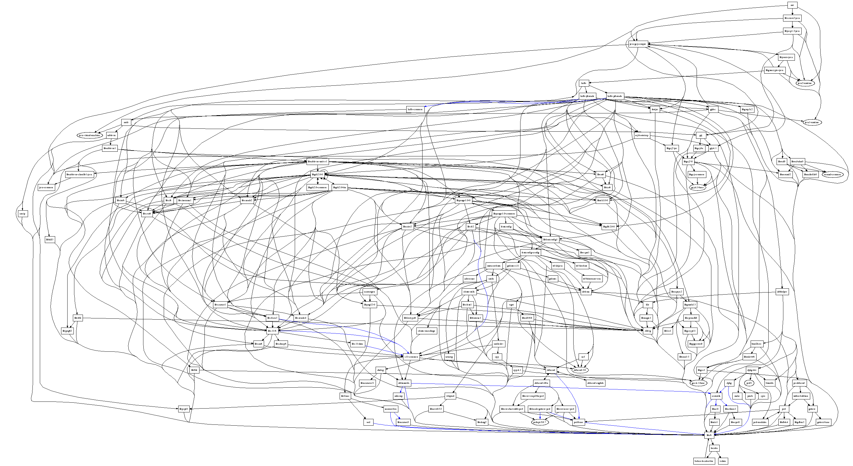
Dependency hell
http://en.wikipedia.org/wiki/Dependency_hell
http://neidetcher.com/ubuntu_package_dependency.html

Slide 44
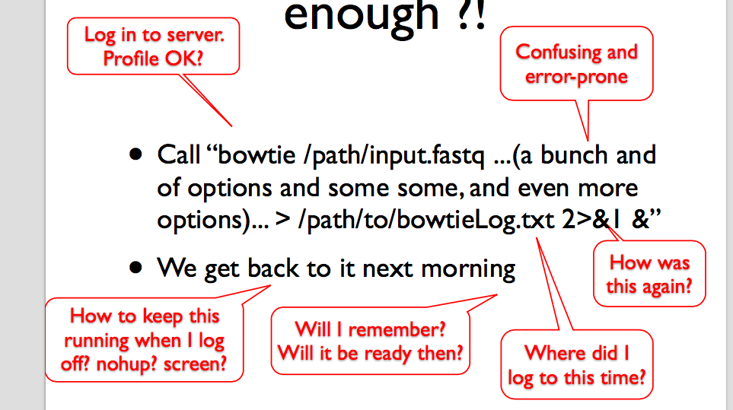
Shell command ‘language’
Sveinung Gundersen, this course

Slide 45
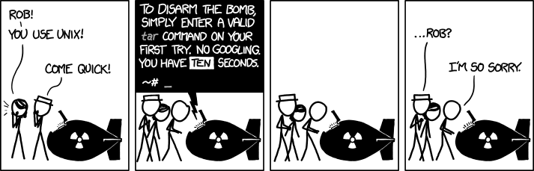
Shell command ‘language’
xkcd.com/1168

Slide 46
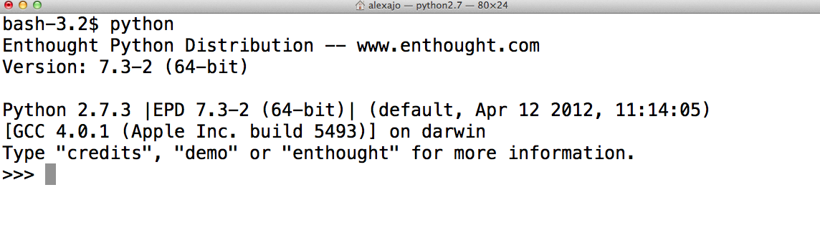
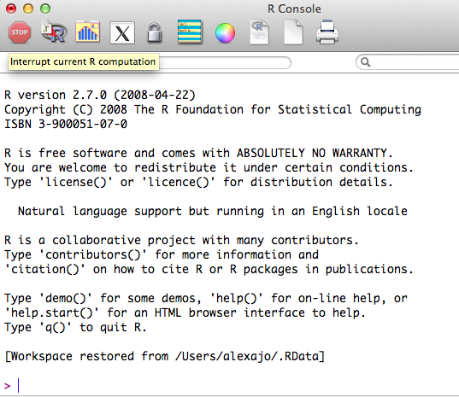
Programming language
✔Powerful, flexible
✖ Learning curve, package/module management

Slide 47
Python versus R
✔Real programming language, easy to learn
✖ Not yet optimal for (bio)statistics
✔Lots of (bio)statistics modules, plotting
✖ Not a good programming language

Slide 48
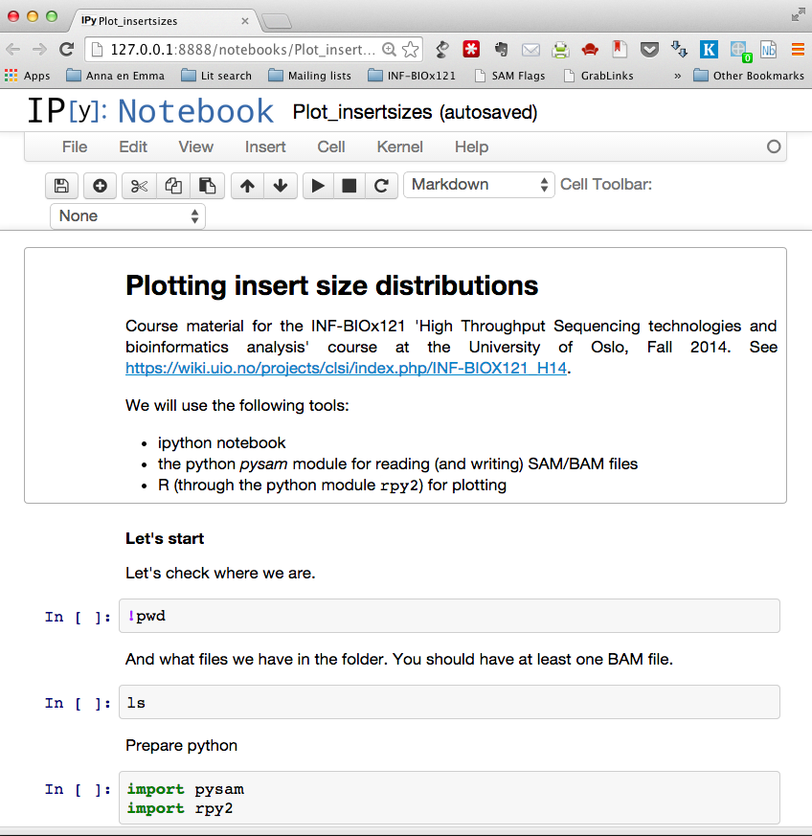
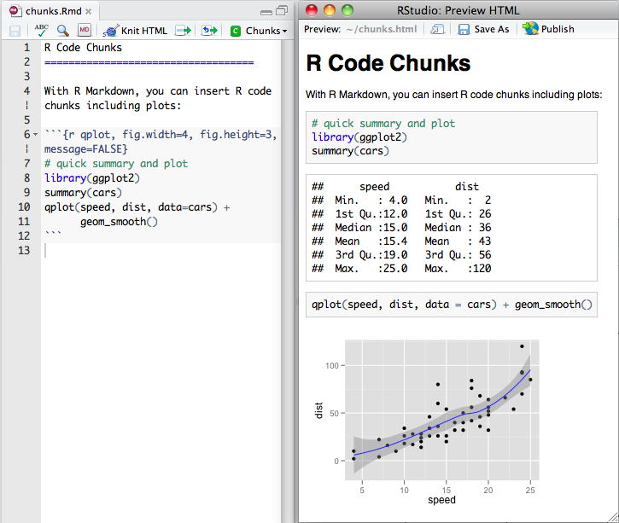
Jupyter/IPython notebook / RStudio
✔Versatile, annotation, sharing
✖ Installation

Slide 49
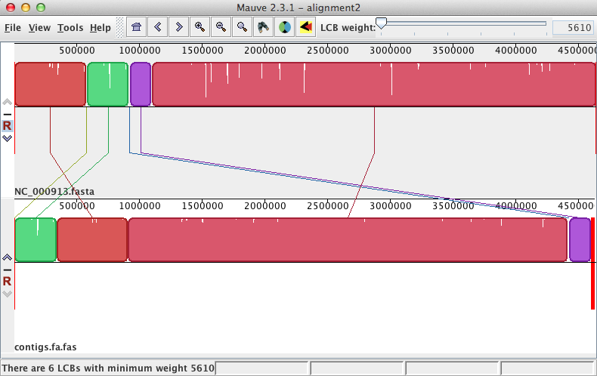
Tool-specific graphical interface
✔No installation, documentation
✖ Each interface different, do one thing only, lack of interoperability (‘piping’)

Slide 50
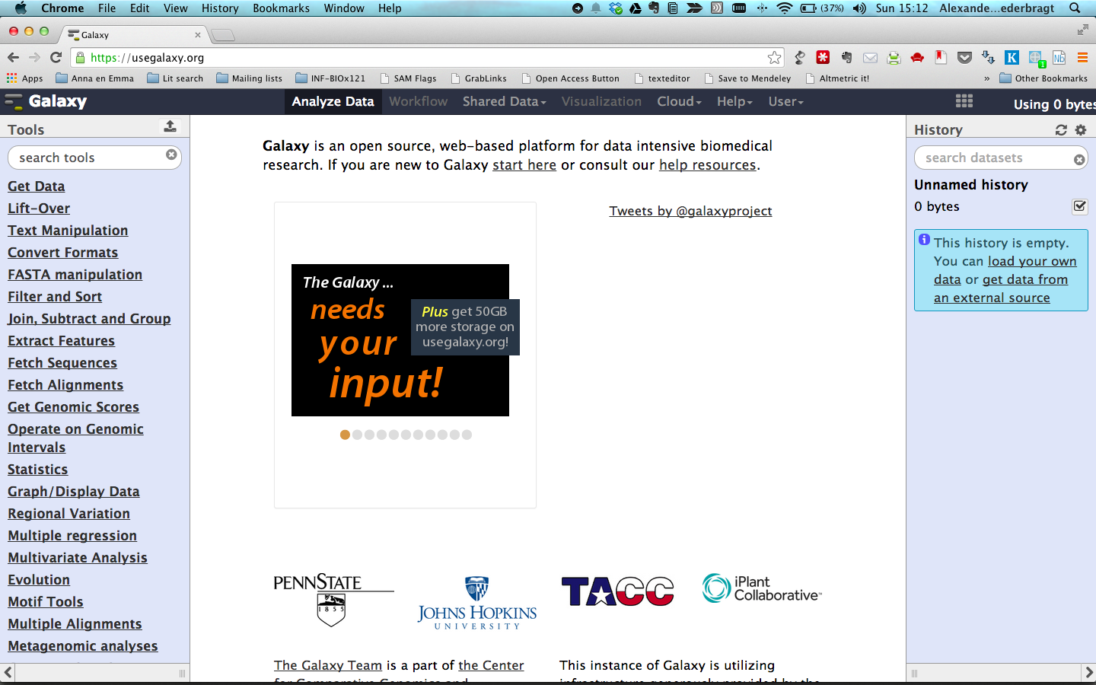
Web-based graphical analysis framework
✔Powerful, unified interface, reproducibility
✖ Does it have your tool?

Slide 51

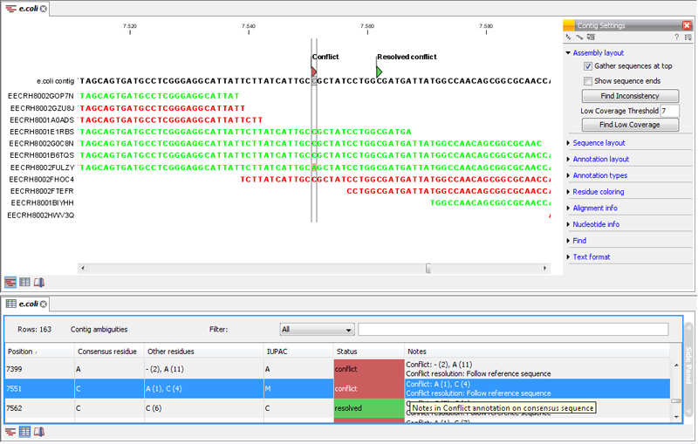
Commercial analysis software
✔Typically very user-friendly, good support
✖ Lock-in, not transparent, often hard to customize

Slide 52
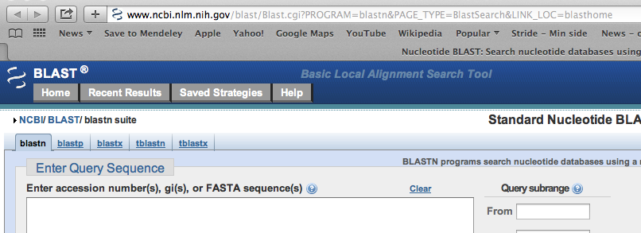
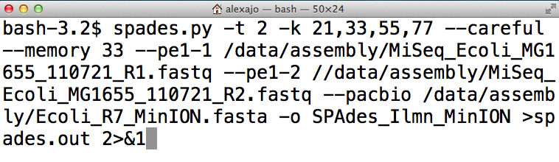
What's best for you?
Bioinformatics = low priority
Web-based solutions
Basic command line to run programs

Slide 53
What's best for you?
Bioinformatics = important, but intermittent
Web-based solutions
IPython notebook
R
Basic command line to run programs

Slide 54
What's best for you?
Bioinformatics = your life
Programming language
More advanced command line

Slide 55
Conclusion
Use the simplest (for you) tools suited for the job!
Do what is effective, not what looks efficient (cool)
It's always good to learn, but it's not necessarily best spent effort

Slide 56
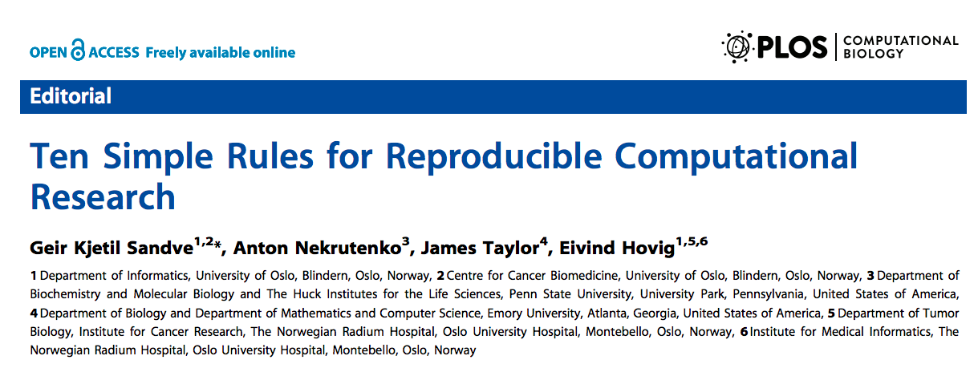
How to become an efficient bioinformatician
http://software-carpentry.org
doi:10.1371/journal.pcbi.1003285

